Slide 1




Opex Analytics
Understanding Customer Feedback Using Text Analytics
Michael Cho
Data Scientist, Opex Analytics

Slide 2



BUSINESS PROBLEM
What are my Customers Talking About?
CUSTOMER FEEDBACK
ACTIONABLE INSIGHTS

Slide 3
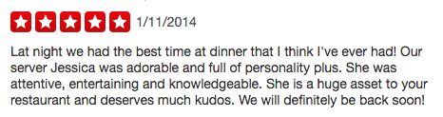
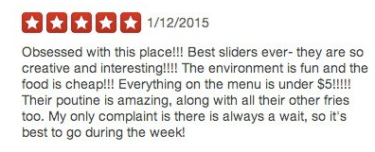
WE WANT TO KNOW WHY THINGS WENT WELL
Real Good Reviews

Slide 4
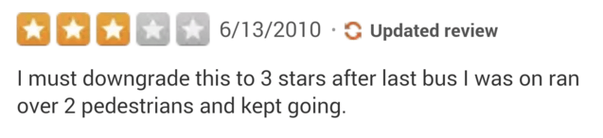
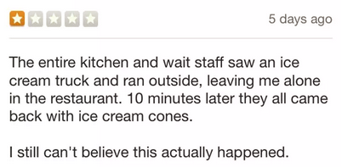
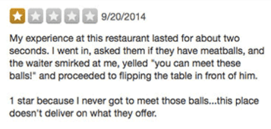
WE WANT TO KNOW WHY THINGS GO BAD
Real Bad Reviews

Slide 5
Case Study – Retail Client
Background
Upon receiving an order from this retail client, the consumer receives an email stating that their product has been delivered, and invites the customer to complete a survey.
Survey consists of several questions, including a free text field where the consumer can write whatever they want about their experience.
Problem Statement
How can this retail client derive insights from these consumer comments?

Slide 6
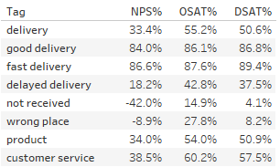
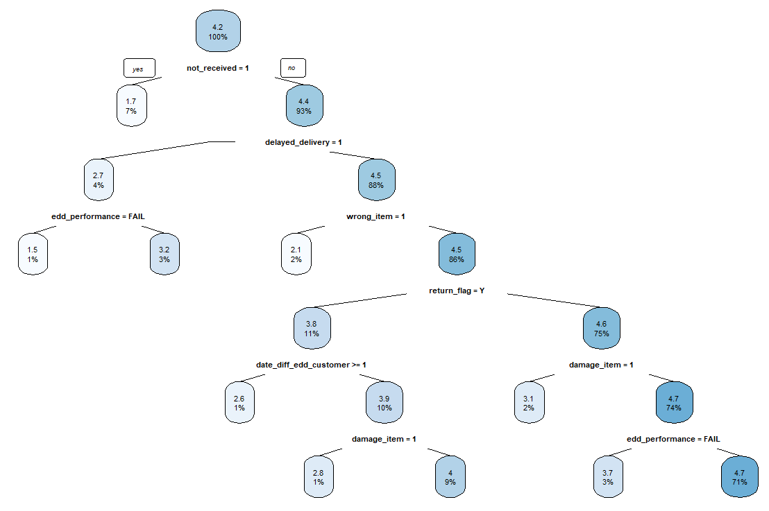
Case Study – Retail Client
Insights
DESCRIPTIVE
PREDICTIVE

Slide 7


Two Approaches
Topic Modelling
Unknown what customer is talking about
Discover categories of topics customers are talking about
Example: When customers are giving bad reviews for a hotel stay, they complain about a) the noise, b) the smell of the room, or c) the hotel staff (previously unknown)
Rule Based Categorization
Key topics that business wants to consider is already known
Target specific topics to categorize
Example: Business only wants feedback from customers talking about returns

Slide 8
Framework
Text Preprocessing
Rule Based Categorization
Topic Modelling

Slide 9
Jupyter Notebook
Introduction
Reading in the Data
Pre-analysis Definitions
Stemming
Lemmatization
Tokenization
Stop Words
Data Preprocessing
Preparing data for tokenization
Tokenizing, Stemming/Lemmatizing, and Removing Stop Words
Word Frequencies
N-grams
Topic Modelling with Gensim
Topic Modelling
Assigning Comments to Topics
Rule Based Categorization
Creating Dictionaries
Tagging Comments

Slide 10
Text Preprocessing

Slide 11
Word Stemming
What is it?
The process by which a word is reduced to its word stem
Example: stay
staying → stay
stayed → stay
stays → stay
Why do it?
Allows a text analytics algorithm to group words with similar meaning together in order to reduce features and decrease the likelihood of overfitting a model

Slide 12
Lemmatization
What is it?
Reducing a word to a core root, while maintaining two key attributes
Actual word
Retains linguistic meaning
Example: picture
pictures → picture

Slide 13
Overstemming vs. Understemming
 | Overstemming | Understemming
Definition | Cutting off to much of an ending from a word, resulting in a loss of linguistic meaning | Not cutting off enough of a word ending, resulting in less word groupings
Most commonly associated with | Stemming | Lemmatization
Positives | More words grouped together; model has less features; lower likelihood of overfitting model | Linguistic meaning retained; output of model more easily explainable
Negatives | Linguistic meaning can be lost; model output not as easily explainable | Less words are grouped together; more features; higher likelihood of overfitting model
Example | Universe → univers Universal → univers Universities → univers University → univers | Universe → universe Universal → universal Universities → university University → university

Slide 14
Tokenization
What is it?
When a string of words is converted into a list of words
Formatting allows for other NLTK methods to be used for text analysis
Example: N-grams
Example of tokenization in action:
Review: “Our experience at Rancho Valencia was absolutely perfect from beginning to end!!!!”
Tokenized Version: ['our’, 'experience’, 'at’, 'rancho’, 'valencia’, 'was', 'absolutely’, 'perfect’, 'from', 'beginning', 'to', 'end’]

Slide 15
Stop Words
There are a lot of common words that can create a lot of noise in your text analysis model
Examples: the, at, a, an, or, was, to, our
These words are known as stop words, and are helpful to remove when creating a text analysis model
Fortunately, NTLK has a pre-defined corpus, which can be accessing using nltk.corpus.stopwords.words('english’)
Example
Raw Tokenized Version: ['our’, 'experience’, 'at’, 'rancho’, 'valencia’, 'was', 'absolutely’, 'perfect’, 'from', 'beginning', 'to', 'end’]
Tokenized Version After Stop Words Removed: ['experience’, 'rancho’, 'valencia’, 'absolutely’, 'perfect’, 'beginning', 'end’]

Slide 16
N-Grams
N-Grams refers to the “contiguous sequence of N items from a given sample of text or speech”
Example:
Tokenized Text: ['experience’, 'rancho’, 'valencia’, 'absolutely’, 'perfect’, 'beginning', 'end’]
Unigrams (1-gram): ['experience’, 'rancho’, 'valencia’, 'absolutely’, 'perfect’, 'beginning', 'end’]
Bigrams (2-gram): [('experience’, 'rancho’), ('rancho’, 'valencia’), ('valencia’, 'absolutely’), ('absolutely’, 'perfect’), ('perfect’, 'beginning’), ('beginning’, 'end’)]
Trigrams (3-gram): [('experience’, 'rancho’, 'valencia’), ('rancho’, 'valencia’, 'absolutely’), ('valencia’, 'absolutely’, 'perfect’), ('absolutely’, 'perfect’, 'beginning’), ('perfect’, 'beginning’, 'end’)]

Slide 17
Topic Modelling

Slide 18
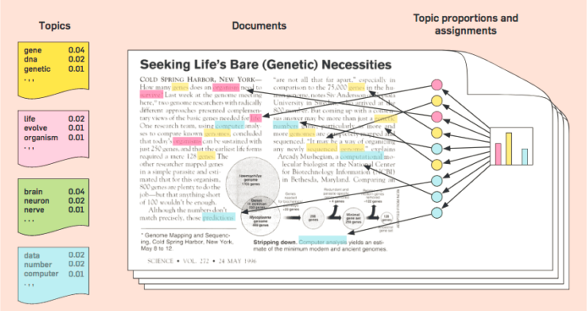
What is Topic Modelling?
Statistical model for discovering “topics” that appear in a collection of documents (or in the case of survey data, comments)
Determined based on word frequency and word similarity

Slide 19
Rule Based Model

Slide 20

Targeting Specific Feedback
Tag
I never got my hat! It said it was delivered at 6am on a Saturday but I would’ve been home then and I never heard a knock (also who delivers packages at 6am?). I want my hat :( I am sad without my hat :( Please send a new hat to my work address so I can have a hat :(
Order Not Received
Product
Tag
My package showed up as if Ace Ventura was the delivery guy. my package showed up as if the UPS guy kicked a field goal with the box before he dropped it off, the shoe box is completely wrecked, and I usually like to keep them. luckily, the shoes themselves are fine, but I’m very disappointed with how they showed up
Damage Package

Slide 21
Questions?

Slide 22
About
Michael Cho
Data Scientist, Opex Analytics
Work with retail clients in Text Analytics, Root-Cause Analysis
Podcast Enthusiast

